Slide 1
SAPTHAGIRI COLLEGE OF ENGINEERING
(Affiliated to Visvesvaraya Technological University, Belagavi & Approved by AICTE, New Delhi.)
Department of Information Science & Engineering
Mobile Application Development Lab
18CSMP68
Installation of Android studio
BY
Prof. SUDARSANAN D
Assistant Prof, Dept of ISE

Slide 2
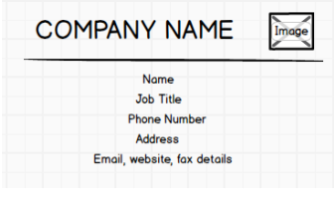
Program 1
Lab Program 1: Create an application to design a Visiting Card. The Visiting card should have a company logo at the top right corner. The company name should be displayed in Capital letters, aligned to the center. Information like the name of the employee, job title, phone number, address, email, fax and the website address is to be displayed. Insert a horizontal line between the job title and the phone number.
click

Slide 3
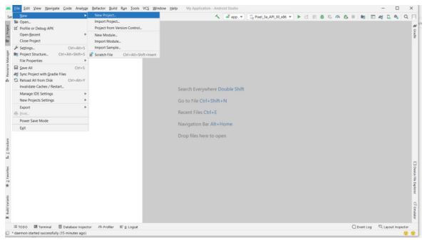
EXECUTION STEPS
Step 1:Create an empty project and name it, Click on file→new→new project

Slide 4
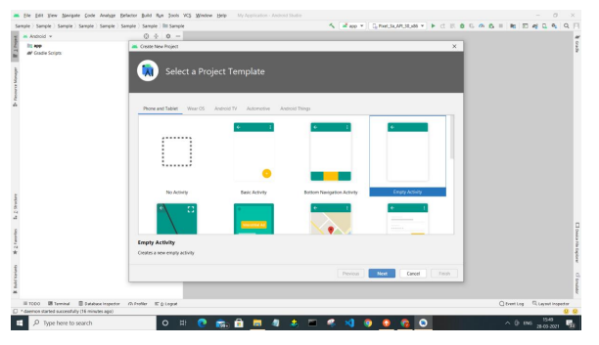
Step-2: Select empty project click on Next.

Slide 5
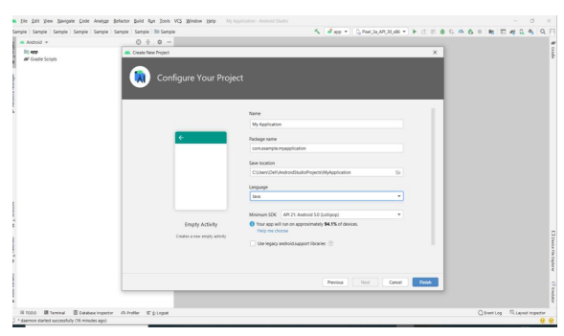
Step 3: Name your application, select language as java and select higher version of Android APIs.

Slide 6
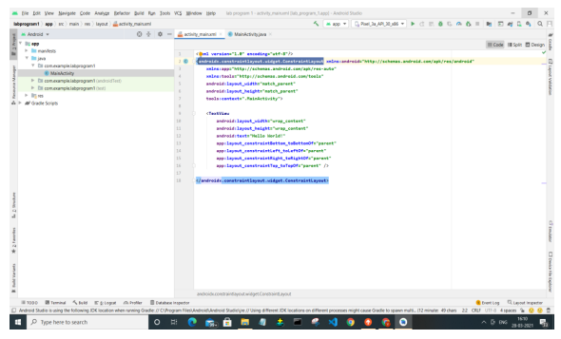
Step 1: Go to XML part in the right side select code in that delete Constraint layout to Linear layout
Step 1:
1. GO TO CODE MENU and Select activity_main.xml
Change Constraint Layout to Linear Layout
After that Inside linear layout , create Relative layout
HOW TO CREATE A RELATIVE LAYOUT
GOTO PALETTE →SELECT LAYOUT → SELECT RELATIVE LAYOUT
Drag and drop inside linear layout( ie COMPONENT TREE)
Now change the relative layout height inside the code block
<Relative layout>
………….
...........
android: layout_height=“125dp”
</Relative layout>
Relative layout
Linear Layout

Slide 7

Step 2 [ With in Relative layout we have to add two component ie COMPANY NAME AND LOGO]
GO TO PALETTE → SELECT TEXT→SELECT TEXTVIEW and drag and drop inside Relative layout
Now go to ATTRIBUTE →SELECT DECLARATION ATTRIBUTE CHANGE ALL DISPLAY PROPERTIES
ie text=SAPTHAGIRI
text_size=24dp
text_style=bold
text_color=red
Now position the Text View in center position by using CONSTRAINTS TECHNIQUE(LIMITATION)
SAPTHAGIRI
SAPTHAGIRI

Slide 8
Step 2 [ADD LOGO]
Note: while downloading image in internet and save it in desktop by giving filename should all small character.jpg. [NO ANY CAPITAL LETTER AND SPECIAL SYMBOLS]
NOW put this image inside android studio inside RES→DRAWABLE FOLDER
GO TO PALETTE → COMMON→SELECT IMAGE VIEW and drag and drop inside Relative layout
Now position the image in right position by using CONSTRAINTS TECHNIQUE(LIMITATION)
SAPTHAGIRI

Slide 9
STEP 3:NOW ADD HORIZONTAL LINE
GOTO PALETTE→WIDGET→SELECT VIEW DRAG AND DROP INSIDE LINEAR LAYOUT
AFTER THAT HORIZONTAL LINE NOT VISIBLE GO TO CODING PART
<VIEW
android:id = “@+id/view
android:layout_width=“wrap-content”
android:layout_height=“2dp”
android:lalyout_weight=“1” //remove
android:background=“black”
SAPTHAGIRI
Still not visible the horizontal line change the code in
Linear layout tag
<linear layout
……………………..
……………………..
Android: orienation=“vertical”
>
Or
Right click linear layout→ linear layout→orientation to vertical
SAPTHAGIRI

Slide 10
Step 4[ ADD TEXT FIELD LIKE NAME,JOB TITILE, PHONE NUMBER, ADDRESS, EMAIL ID , FAX]
GOTO PALETTE→TEXT→SELECT TEXTVIEW DRAG AND DROP IN LINEAR LAYOUT
SAPTHAGIRI
SUDARSANAN D
MANAGER
9535937675
BANGALORE
sudarsanand@sapthagiri.edu.in

Slide 11
Step 5[ ADD HORIZONTAL LINE BETWEEN JOB TITLE
GOTO PALETTE→WIDGET→SELECT VIEW DRAG AND DROP BETWEEN JOB TITLE AND PHONE NUMBER
NOW TO VISIBLE THE HORIZONTAL LINE WE HAVE TO GOTO XML CODE
<view
……………………………
……………………………
android: layout-height=“2dp”
android:background=“@color/black”/>
SAPTHAGIRI
SUDARSANAN D
MANAGER
9535937675
BANGALORE
sudarsanand@sapthagiri.edu.in

Slide 12
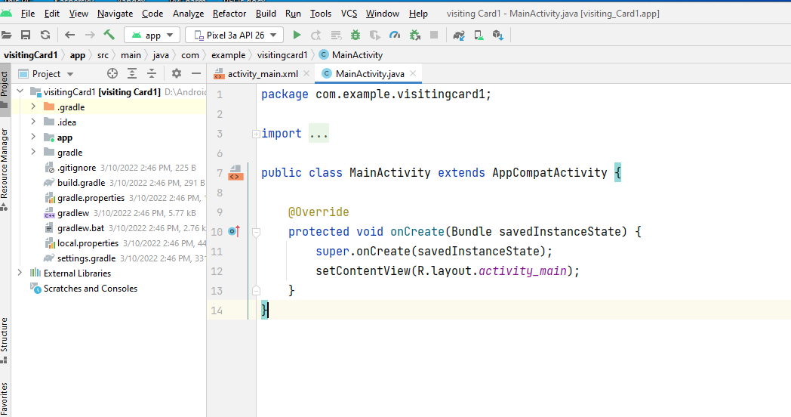
Step 6: [ click run button to synchronize hardware device]
click

Slide 13
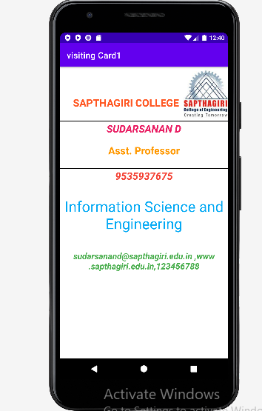
Output:

